Slide 1


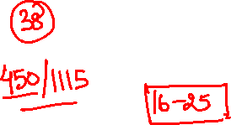
ABHAY MAHAJAN
B.Tech. IIT Roorkee
11+ years teaching experience
Mentored and taught around 20000+ students
Produced 400+ IIT selections
10+ INMO selections
1 EGMO Selection

Slide 2


Slide 3
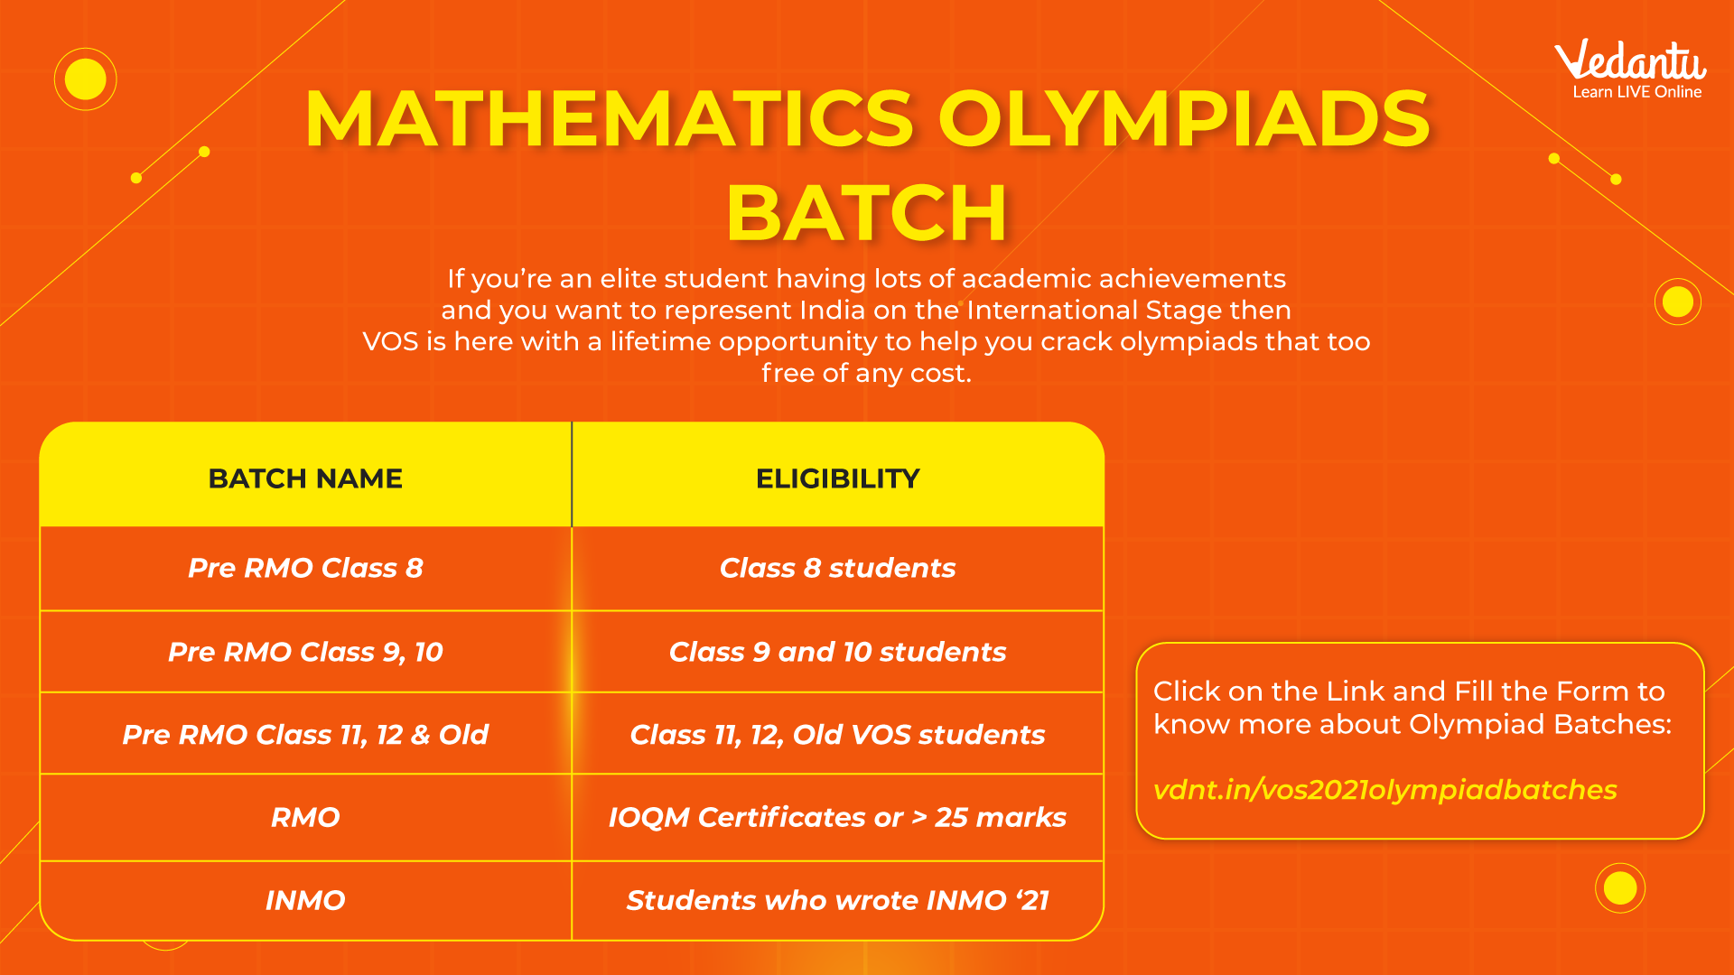


Slide 4



Slide 5




Kindly attempt the Session Assignment
that follows
NOTE: Solution also attached

Slide 6
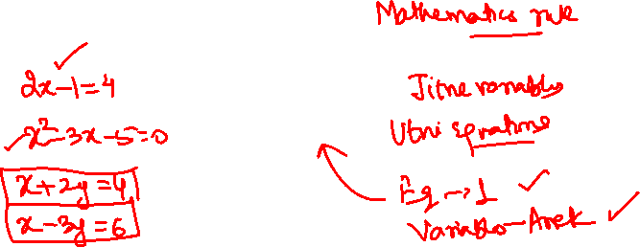
Diophantine Equations

Slide 7
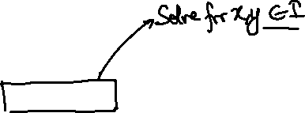
DIOPHANTINE EQUATION
An equation with more than one variable for which integral solutions are required is called
Diophantine equation.
Type 1:
The simplest and typical equation is
ax + by = c ….. (1)
where a, b, c are constant integers.

Slide 8
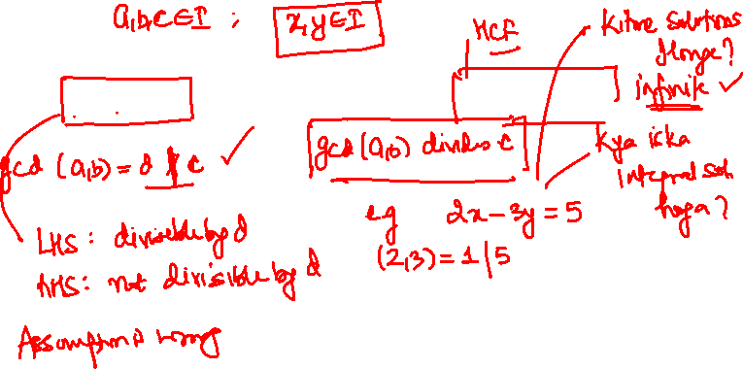
THEOREMS
Theorem 1:
The equation ax + by = c has integer solutions iff gcd (a, b) | c.

Slide 9
THEOREMS
Theorem 1:
The equation ax + by = c has integer solutions iff gcd (a, b) | c.
Proof:
Assume gcd (a,b) does NOT divide c.
If (x, y) is an integer solution of ax + by = c, then left hand side is divisible by gcd (a, b), whereas the right-hand side is not, a contradiction.
If (a, b) | c, then, after dividing by (a, b), the equation becomes
a’x + b’y = c’
where a’, b’, c’ are integers and (a’, b’) = 1.

Slide 10
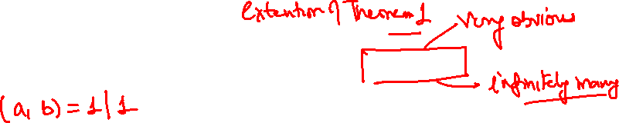
THEOREMS
Theorem 2:
If (a, b) = 1, then there exists x, y ∈ Z such that ax + by = 1.

Slide 11
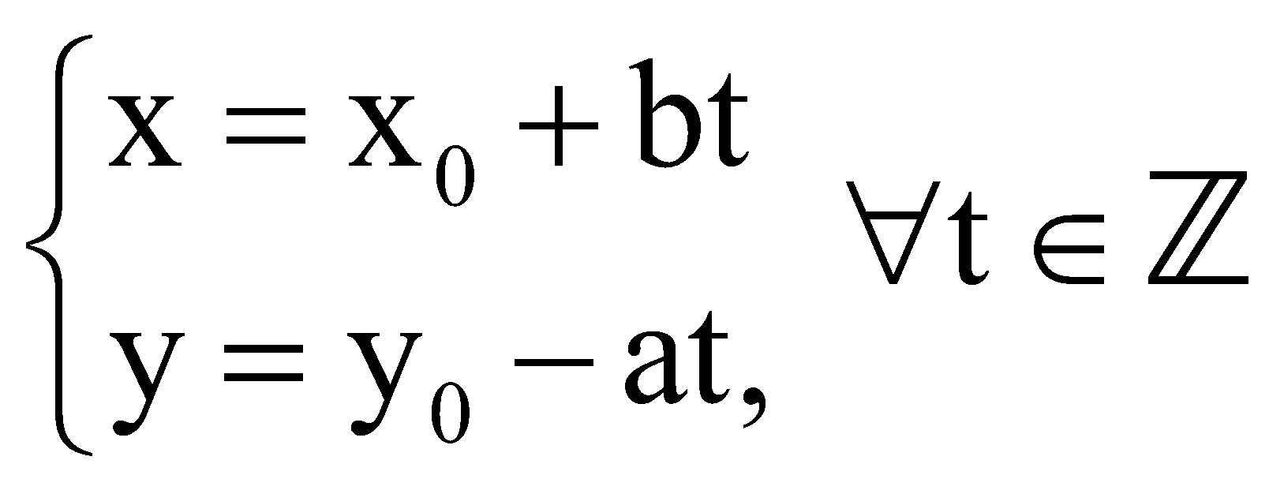
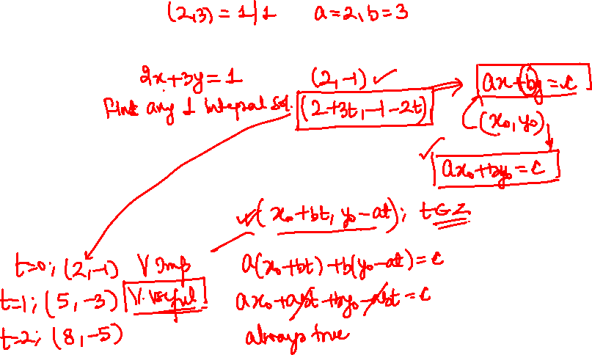
THEOREMS
Theorem 3:
If x₀, y₀ is a special integer solution of the equation
ax + by = c, then its general solution is given by

Slide 12
NOTES
(i) For solving a Diophantine equation based on the Theorem 3, we can ﬁnd the general solution if a special solution is given or can be found easily, then determine the range or values of t according to the given conditions in question.
(ii) For solving a system of Diophantine equations or an equation with more than two variables, substitution method can be used for simplifying the equation.

Slide 13
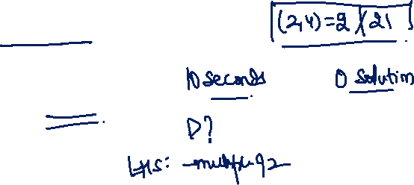
Q. The number of integer solutions of the equation
2x + 4y = 21 is
A
Zero
B
One
C
Three
D
Infinite

Slide 14
Q. The number of integer solutions of the equation
2x + 4y = 21 is
A
Zero
B
One
C
Three
D
Infinite

Slide 15
Solution :
Since gcd (2, 4) = 2,
And 2 does not divide 21.
So, the equation 2x + 4y = 21 has no integer solution.

Slide 16
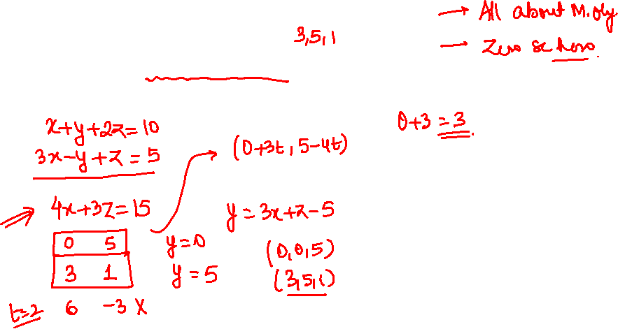
Q. If we solve the following system of equations
x+ y+ 2z = 10, 3x – y+z =5,
Where x, y, z are non-negative integers, what is the sum of all possible values of x?

Slide 17
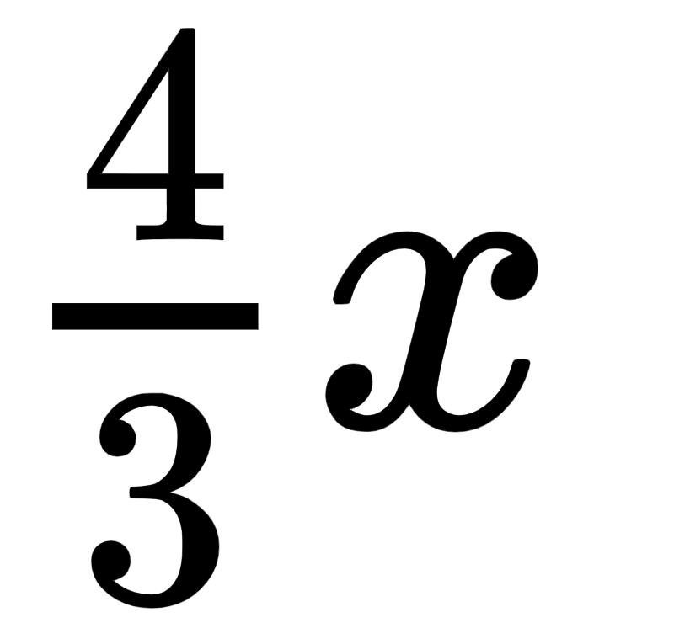
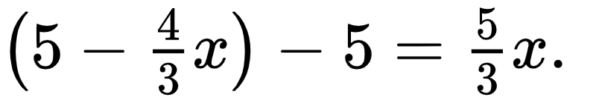
Solution :
For the given equations
x + y + 2z = 10 (1)
3x – y + z = 5, (2)
(1) + (2) gives
4x + 3z = 15 ⇒ z = 5 –
Substituting it inot (2) gives
y = 3x + z – 5 = 3x +
With non-negativity condition, we have
Therefore, the sum of all possible values of x is 0 + 3 = 3.

Slide 18

DIOPHANTINE EQUATION
Type 2: Basic Methods for solving Quadratic Equations on Z
Factorization Method:
Let the right hand side of the equation be a
constant, zero or a power of a prime number
(in the case of quadratic equation), and
factorize the left hand side to the form of
product of linear factors, then discuss the
possible values of the linear factors based on
the factorization of the right hand side.

Slide 19
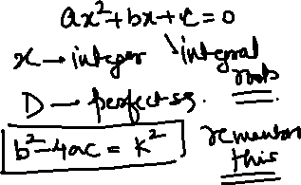
DIOPHANTINE EQUATION
Discriminant Method:
When a quadratic equation with integer coefﬁcients has integer solution(s), its discriminant must be a perfect square. This feature will play an important role. When the quadratic equation contains two variables x; y,by the formula for roots, x can be expressed in terms of y, and its discriminant is an expression in y. Since the discriminant is a perfect square and that y is an integer, y can be found easily.
Note: Besides the use of discriminant, use of Vieta Theorem and transformation or substitution are also useful tools for solving quadratic equations.

Slide 20

DIOPHANTINE EQUATION
Congruence, divisibility and parity analysis, etc. are often used in discussing the existence of integer solutions of quadratic equations.

Slide 21
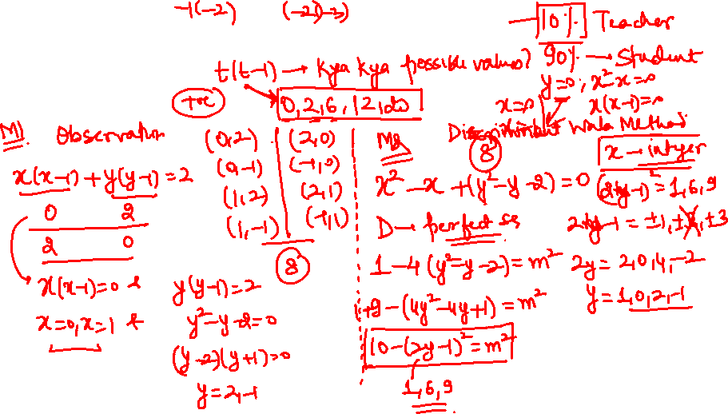
Q. Find integral solutions x, y such that
x² + y² = x + y + 2.

Slide 22
Solution :
Method: 1
x² – x + y² – y – 2 = 0
D = 1 – 4(y² – y – 2) = –4y² + 4y + 9
= – [4y² – 4y] + 9 = – [4y² – 4y + 1] + 10 = – [2y – 1]² + 10
y = 0, 1, 2, –1
y = 0 ⇒ x = 2, –1
y = 1 ⇒ x = 2, –1
y = –1 ⇒ x = 0, 1
y = 2 ⇒ x = 0, 1
(x, y) = (2, 0), (-1, 0), (2, 1), (-1, 1), (0, -1), (1, -1), (0, 2), (1, 2)
Method: 2
x(x - 1) + y(y - 1) = 2
x(x - 1) take values 0, 2, 6, …..
0 + 2 and 2 + 0 cases possible
x(x – 1) = 0 & y(y – 1) = 2 OR x(x – 1) = 2 & y(y – 1) = 0
⇒ x = 0, 1 & y = –1, 2 OR y = 0, 1 & x = –1, 2

Slide 23
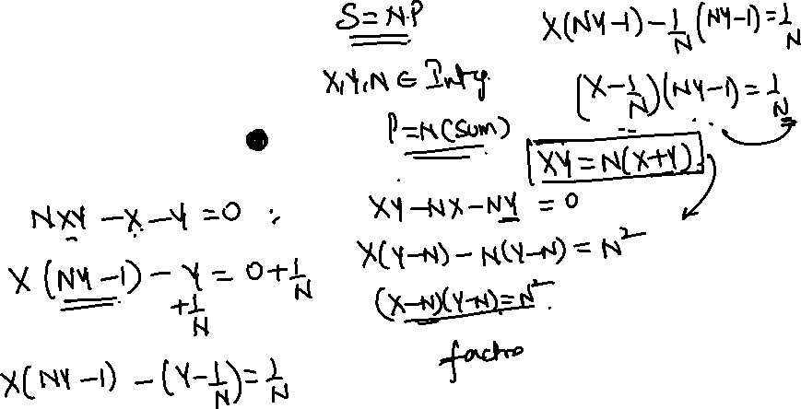
Let’s Solve :
X + Y = N(X+ Y)

Slide 24
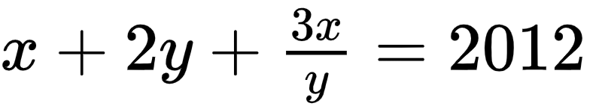
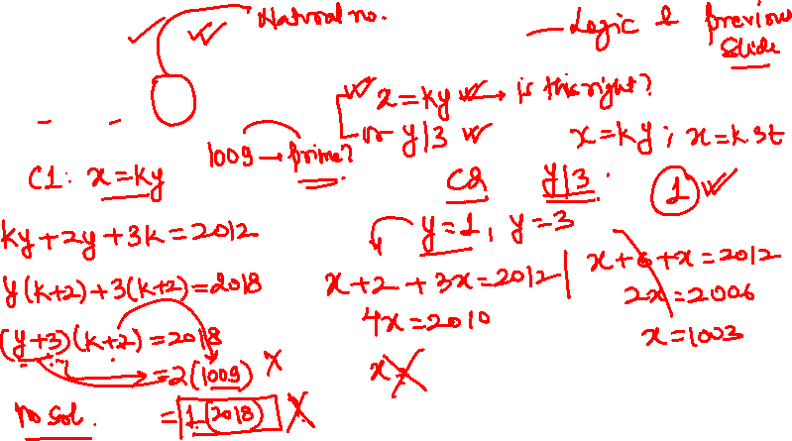
Q. Find Number of pairs(x, y) here x, y ∈ ℕ for which the relation
A
0
B
1
C
2
D
3

Slide 25
Q. Find Number of pairs(x, y) here x, y ∈ ℕ for which the relation
A
0
B
1
C
2
D
3

Slide 26
Solution :
y | 3x and so(x,y) = (uv, v) or (uv, 3u) where u, v ∈ ℕ
(x, y) = (uv, v) ⇒uv + 2v + 3u = 2012
⇒ (u + 2)(v + 3) = 2018 = 2 × 1009 and no solution
(x, y) = (uv, 3v) ⇒ uv + 6v + u = 2012
⇒(u + 6)(v + 1) = 2018 = 2 × 1009 and
the unique solution (u, v) = (1003, 1)
Hence the answer (x, y) = (1003, 3).

Slide 27
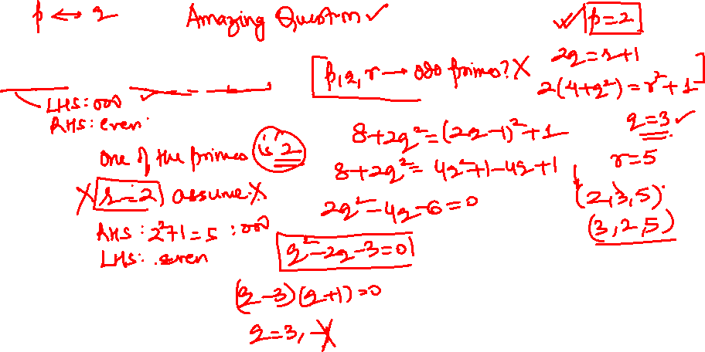
RMO 2013
Q. Find number of triples (p, q, r) of primes such that pq = r + 1 and 2(p² + q²) = r² + 1.
A
0
B
1
C
2
D
5

Slide 28
Q. Find number of triples (p, q, r) of primes such that pq = r + 1 and 2(p² + q²) = r² + 1.
A
0
B
1
C
2
D
5

Slide 29
Solution :
If p and q are both odd. then r = pq - 1 is even so r = 2. But in this case
pq ≥ 3 × 3 = 9 and hence there are no solutions.
This proves that either p = 2 or q = 2. If p = 2
then we have 2q = r + 1 and 8 + 2q² = r² + 1.
Multiplying the second equation by 2
we get 2r² + 2 = 16 + (2q)² = 16 + (r + 1)².
Rearranging the terms, we have r² - 2r - 15 = 0.
or equivalently (r + 3)(r - 5) = 0. Thus proves that r = 5 and hence q = 3. Similarly, if q = 2 then r = 5 and p = 3.
Thus the only two solutions are
(p, q, r) = (2, 3, 5) and (p, q, r) = (3. 2, 5).

Slide 30
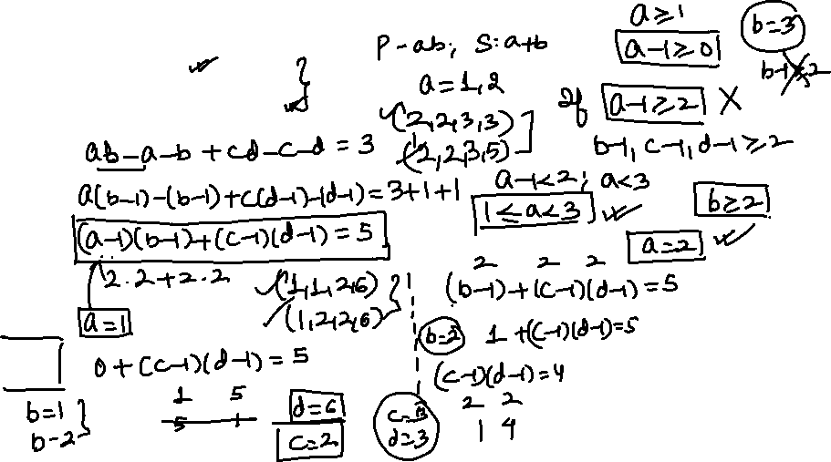
RMO 2002
Q. Find number of integer pairs a, b, c, d satisfying the following relations:
(i) 1 ≤ a ≤ b ≤ c ≤ d;
(ii) ab + cd = a + b + c + d + 3.
A
0
B
1
C
2
D
4

Slide 31
Q. Find number of integer pairs a, b, c, d satisfying the following relations:
(i) 1 ≤ a ≤ b ≤ c ≤ d;
(ii) ab + cd = a + b + c + d + 3.
A
0
B
1
C
2
D
4

Slide 32
Solution :
We may write (ii) in the form
ab − a − b + 1 + cd − c − d + 1 = 5. Thus we obtain the equation (a − 1)(b − 1) + (c − 1)(d − 1) = 5. If a − 1 ≥ 2.
then (i) shows that b − 1 ≥ 2, c − 1 ≥ 2 and d − 1 ≥ 2 so that
(a − 1)(b − 1) + (c − 1)(d − 1) ≥ 8. It follows that a − 1 = 0 or 1.
If a − 1 = 0, then the contribution from (a − b)(b - 1) to the sum is zero for any choice of b. But then
(c − 1)(d − 1) = 5 implies that c − 1 = 1 and d − 1 = 5 by (i).
Again (i) shows that b − 1 = 0 or 1 since b ≤ c. Taking
b − 1 = 0, c − 1 = 1 and d − 1 = 5 we get the solution
(a, b, c,d) = (1, 1, 2, 6).
Similarly, b − 1 = 1, c − 1 = 1 and d − 1 = 5 gives
(a, b, c, d) = (1, 2, 2, 6). In the other case a - 1 = 1. we see that b - 1 = 2 is not possible for then c − 1 ≥ 2 and d − 1 ≥ 2.
Thus b − 1 = 1 and this gives (c − 1)(d − 1) = 4.
It follows that c − 1 = 1, d − 1 = 4 or c − 1 = 2, d − 1 = 2. Considering each of these, we get two more
solutions: (a, b, c, d) = (2, 2, 2, 5), (2, 2, 3, 3).

Slide 33
SAWAAL

Slide 34
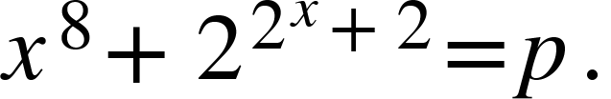
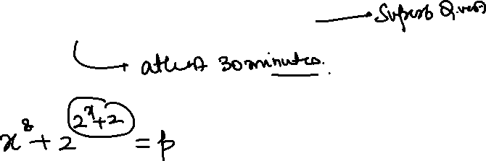
Q. Find number of pairs (x, p) here x is integer and p is prime, satisfying
A
1
B
2
C
3
D
Infinite
Note: Solution at the End

Slide 35
Kindly attempt the Session Assignment
that follows
NOTE: Solution also attached

Slide 39




Let’s Bring
GOLD
For
INDIA

Slide 40
Q. Find number of pairs (x, p) here x is integer and p is prime, satisfying
A
1
B
2
C
3
D
Infinite

Slide 41
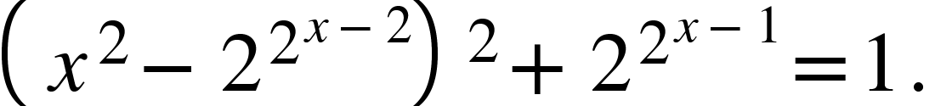
Solution :
Not hard to see x is non-negative integer and for x's less than 3 we only have a pair
(x, p) = (1, 17) is solution!
For x’ greater than or equal to 3.
We have:
or p =
But p is prime so
it's equivalent to
This is impossible! And we done!

